Slide 1
Blacktown Chinese Christian Church
Welcome to Our English Service 17.11.2024
English Service 9:45 – 11:00 am
Worship Songs: Passage: Speaker: Topic: Response Song: Announcements and Closing Prayer Benediction
Man Of Sorrows Nothing But The Blood Of Jesus Good Good Father 1 Corinthians 1 TBA TBA TBA

Slide 2
BCCC english service

Slide 3

Please keep all phones on silent

Slide 4
Man Of Sorrows
Brooke Ligertwood, Matt Crocker © 2012 Hillsong Music Publishing Australia CCLI Licence No. 5485849 . CCLI Song number: 6476063

Slide 5
Verse 1
Man of Sorrows, Lamb of God
By His own betrayed
The sin of men and wrath of God
Has been on Jesus laid

Slide 6
Verse 2
Silent as He stood accused
Beaten, mocked, and scorned
Bowing to the Father's will
He took a crown of thorns

Slide 7
Chorus
Oh that rugged cross, my salvation
Where Your love poured out over me
Now my soul cries out "Hallelujah!"
Praise and honour unto Thee

Slide 8
Verse 3
Sent of heaven, God's own Son
To purchase and redeem
And reconcile the very ones
Who nailed Him to that tree

Slide 9
Chorus
Oh that rugged cross, my salvation
Where Your love poured out over me
Now my soul cries out "Hallelujah!"
Praise and honour unto Thee

Slide 10
Bridge
Now my debt is paid, it is paid in full
By the precious blood that my Jesus spilled
Now the curse of sin has no hold on me
Whom the Son sets free, oh is free indeed! (x2)

Slide 11
Chorus
Oh that rugged cross, my salvation
Where Your love poured out over me
Now my soul cries out "Hallelujah!"
Praise and honour unto Thee

Slide 12
Verse 4
See, the stone is rolled away
Behold the empty tomb
Hallelujah, God be praised
He's risen from the grave!

Slide 13
Chorus
Oh that rugged cross, my salvation
Where Your love poured out over me
Now my soul cries out "Hallelujah!"
Praise and honour unto Thee

Slide 14
Outro
Praise and honour unto Thee

Slide 15
Nothing But The Blood Of Jesus
Robert Lowry © Words: Public Domain Music: Public Domain CCLI Licence No. 5485849. CCLI Song number: 21332

Slide 16
Verse 1
What can wash away my sin?
Nothing but the blood of Jesus
What can make me whole again?
Nothing but the blood of Jesus

Slide 17
Verse 2
For my pardon this I see
Nothing but the blood of Jesus
For my cleansing this my plea
Nothing but the blood of Jesus

Slide 18
Chorus
Oh, precious is the flow
That makes me white as snow
No other fount I know
Nothing but the blood of Jesus

Slide 19
Verse 3
This is all my hope and peace
Nothing but the blood of Jesus
This is all my righteousness
Nothing but the blood of Jesus

Slide 20
Chorus
Oh, precious is the flow
That makes me white as snow
No other fount I know
Nothing but the blood of Jesus

Slide 21
Verse 4
Glory glory this I see
Nothing but the blood of Jesus
All my praise for this I bring
Nothing but the blood of Jesus

Slide 22
Chorus
Oh, precious is the flow
That makes me white as snow
No other fount I know
Nothing but the blood of Jesus (x2)

Slide 23
Good Good Father
Anthony Brown, Pat Barrett © 2014 Capitol CMG Paragon (Admin. by SHOUT! Music Publishing Australia) Common Hymnal Digital (Admin. by SHOUT! Music Publishing Australia) CCLI Licence No. 5485849 . CCLI Song number: 7036612

Slide 24
Verse 1
Oh I've heard a thousand stories of
What they think You're like
But I've heard the tender whisper of
Love in the dead of night

Slide 25
Verse 1
And You tell me that You're pleased
And that I'm never alone

Slide 26
Chorus
You're a Good, Good Father
It's who You are
It's who You are
It's who You are

Slide 27
Chorus
And I'm loved by You
It's who I am
It's who I am
It's who I am

Slide 28
Verse 2
Oh I've seen many searching for answers far and wide
But I know we're all searching
For answers only You provide
Cause You know just what we need, before we say a word

Slide 29
Chorus
You're a Good, Good Father
It's who You are
It's who You are
It's who You are

Slide 30
Chorus
And I'm loved by You
It's who I am
It's who I am
It's who I am

Slide 31
Bridge
You are perfect in all of Your ways
You are perfect in all of Your ways
You are perfect in all of Your ways
To us

Slide 32
Bridge
You are perfect in all of Your ways
You are perfect in all of Your ways
You are perfect in all of Your ways
To us

Slide 33
Verse 3
Oh, it's love so undeniable
I, I can hardly speak
Peace so unexplainable
I, I can hardly think

Slide 34
Verse 3
As You call me deeper still
As You call me deeper still
As You call me deeper still
Into love, love, love

Slide 35
Chorus
You're a Good, Good Father
It's who You are
It's who You are
It's who You are

Slide 36
Chorus
And I'm loved by You
It's who I am
It's who I am
It's who I am

Slide 37
Chorus
You're a Good, Good Father
It's who You are
It's who You are
It's who You are

Slide 38
Chorus
And I'm loved by You
It's who I am
It's who I am
It's who I am

Slide 39
Chorus
You're a Good, Good Father
It's who You are
It's who You are
It's who You are

Slide 40
Chorus
And I'm loved by You
It's who I am
It's who I am
It's who I am

Slide 41
Bridge
You are perfect in all of Your ways
You are perfect in all of Your ways
You are perfect in all of Your ways
To us

Slide 42

Bible reading

Slide 43
Bible reading: 1 Corinthians 1
Paul, called to be an apostle of Christ Jesus by the will of God, and our brother Sosthenes,
² To the church of God in Corinth, to those sanctified in Christ Jesus and called to be his holy people, together with all those everywhere who call on the name of our Lord Jesus Christ—their Lord and ours:

Slide 44
Bible reading: 1 Corinthians 1
³ Grace and peace to you from God our Father and the Lord Jesus Christ.
⁴ I always thank my God for you because of his grace given you in Christ Jesus.

Slide 45
Bible reading: 1 Corinthians 1
⁵ For in him you have been enriched in every way—with all kinds of speech and with all knowledge— ⁶ God thus confirming our testimony about Christ among you.

Slide 46
Bible reading: 1 Corinthians 1
⁷ Therefore you do not lack any spiritual gift as you eagerly wait for our Lord Jesus Christ to be revealed. ⁸ He will also keep you firm to the end, so that you will be blameless on the day of our Lord Jesus Christ.

Slide 47
Bible reading: 1 Corinthians 1
⁹ God is faithful, who has called you into fellowship with his Son, Jesus Christ our Lord.
¹⁰ I appeal to you, brothers and sisters, in the name of our Lord Jesus Christ, that all of you agree with one another in what you say and that there be no divisions among you, but that you be perfectly united in mind and thought.

Slide 48
Bible reading: 1 Corinthians 1
¹¹ My brothers and sisters, some from Chloe’s household have informed me that there are quarrels among you. ¹² What I mean is this: One of you says, “I follow Paul”; another, “I follow Apollos”; another, “I follow Cephas”; still another, “I follow Christ.”

Slide 49
Bible reading: 1 Corinthians 1
¹³ Is Christ divided? Was Paul crucified for you? Were you baptized in the name of Paul? ¹⁴ I thank God that I did not baptize any of you except Crispus and Gaius,

Slide 50
Bible reading: 1 Corinthians 1
¹⁵ so no one can say that you were baptized in my name. ¹⁶ (Yes, I also baptized the household of Stephanas; beyond that, I don’t remember if I baptized anyone else.)

Slide 51
Bible reading: 1 Corinthians 1
¹⁷ For Christ did not send me to baptize, but to preach the gospel—not with wisdom and eloquence, lest the cross of Christ be emptied of its power.
¹⁸ For the message of the cross is foolishness to those who are perishing, but to us who are being saved it is the power of God.

Slide 52
Bible reading: 1 Corinthians 1
¹⁹ For it is written:
“I will destroy the wisdom of the wise;
the intelligence of the intelligent I will frustrate.”
²⁰ Where is the wise person? Where is the teacher of the law? Where is the philosopher of this age? Has not God made foolish the wisdom of the world?

Slide 53
Bible reading: 1 Corinthians 1
²¹ For since in the wisdom of God the world through its wisdom did not know him, God was pleased through the foolishness of what was preached to save those who believe. ²² Jews demand signs and Greeks look for wisdom,

Slide 54
Bible reading: 1 Corinthians 1
²³ but we preach Christ crucified: a stumbling block to Jews and foolishness to Gentiles, ²⁴ but to those whom God has called, both Jews and Greeks, Christ the power of God and the wisdom of God.

Slide 55
Bible reading: 1 Corinthians 1
²⁵ For the foolishness of God is wiser than human wisdom, and the weakness of God is stronger than human strength.
²⁶ Brothers and sisters, think of what you were when you were called. Not many of you were wise by human standards; not many were influential; not many were of noble birth.

Slide 56
Bible reading: 1 Corinthians 1
²⁷ But God chose the foolish things of the world to shame the wise; God chose the weak things of the world to shame the strong. ²⁸ God chose the lowly things of this world and the despised things—and the things that are not—to nullify the things that are,

Slide 57
Bible reading: 1 Corinthians 1
²⁹ so that no one may boast before him. ³⁰ It is because of him that you are in Christ Jesus, who has become for us wisdom from God—that is, our righteousness, holiness and redemption.

Slide 58
Bible reading: 1 Corinthians 1
³¹ Therefore, as it is written: “Let the one who boasts boast in the Lord.”

Slide 59
Announcements

Slide 60





Account name: Blacktown Chinese Christian Church
Account number: 4216 50263
Offering
BSB: 112 - 879
Please put in "offering" as the reference
The offering box is available at the back of the hall

Slide 61
Prayer points

Slide 62
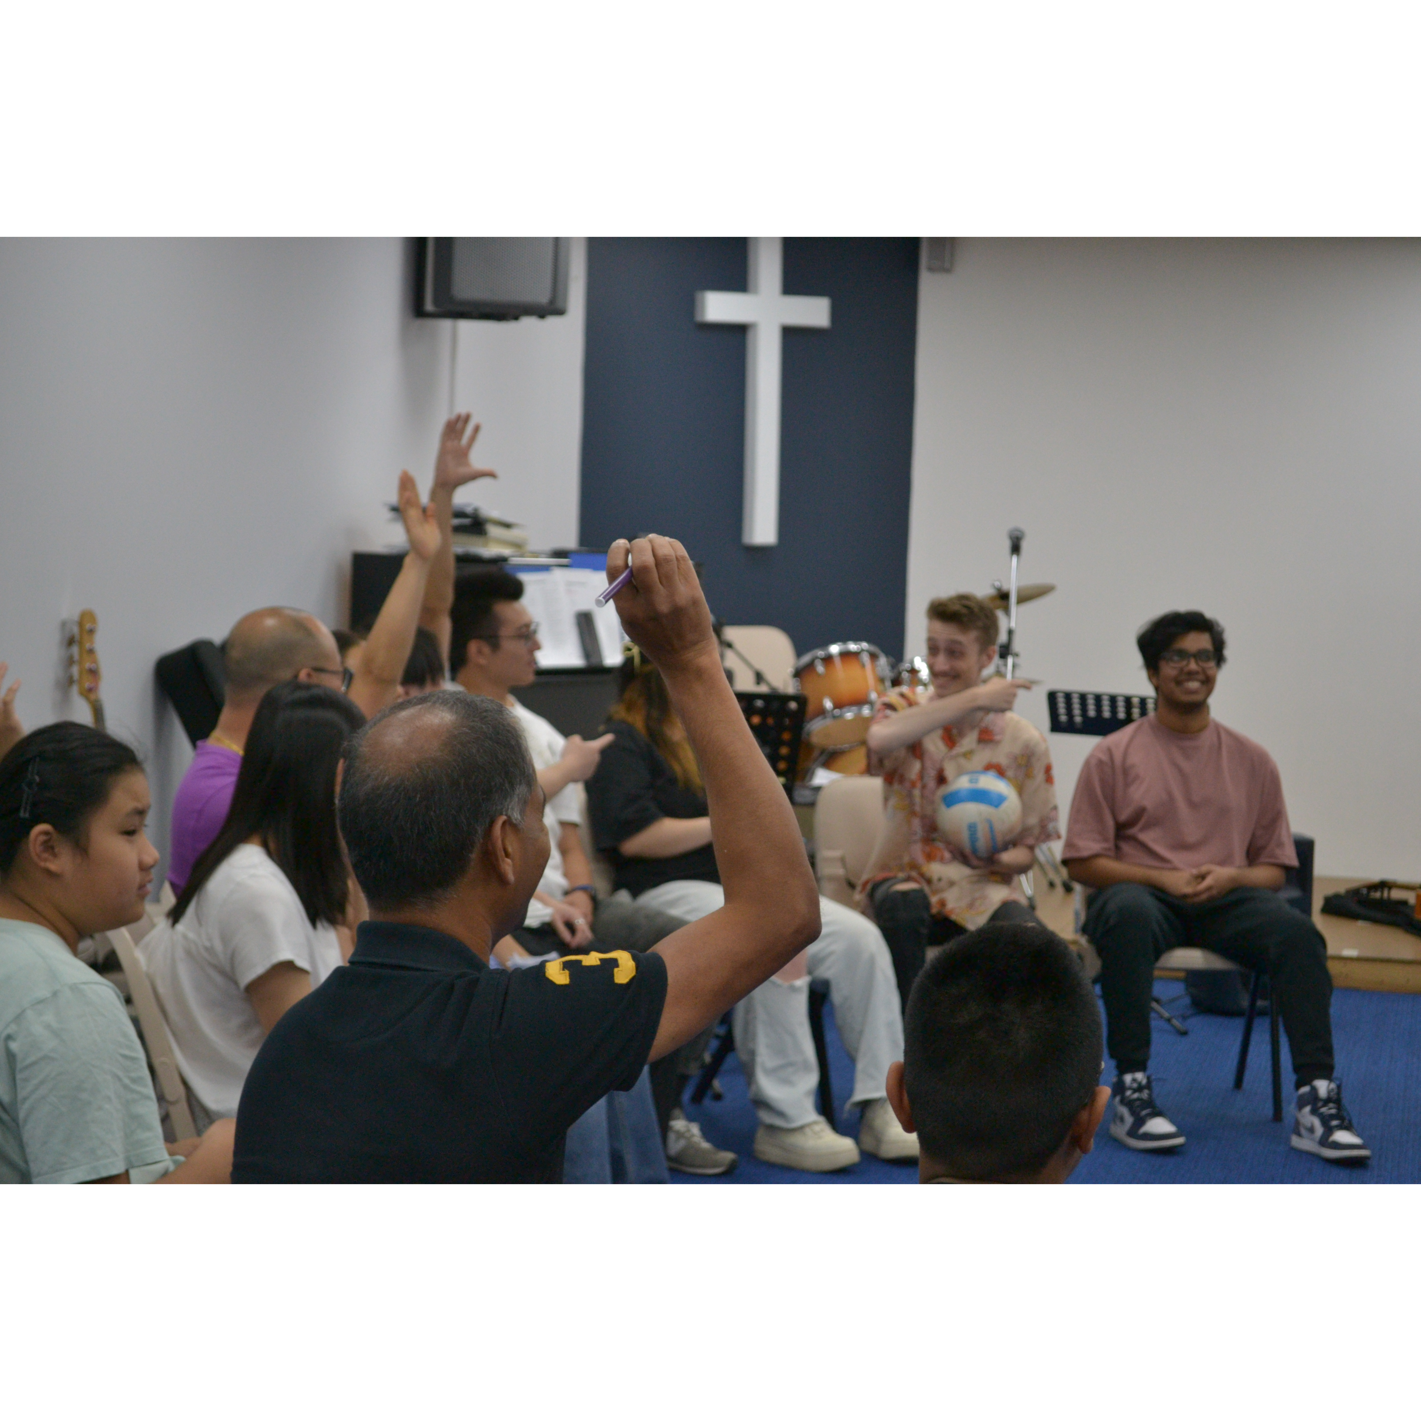
Mingle time!

